Slide 1
BANKING APPLICATION
J011, J013, J014

Slide 2


MAD
PROBLEM STATEMENT
SCREENSHOT
BLOCK DIAGRAM

Slide 3
PROBLEM STATEMENT
The problem statement for a banking app that only shows transaction and history is to provide a user-friendly and secure platform that allows customers to view their transaction history in a clear and concise manner. The app should allow users to view their past transactions. The app should have a simple and intuitive interface that allows users to navigate easily, and should be accessible on multiple platforms such as desktop and mobile devices. The app should also ensure that user data is secure and protected, with robust authentication and encryption measures in place to prevent unauthorized access to user accounts and information.

Slide 4
SCREENSHOTS

Slide 5
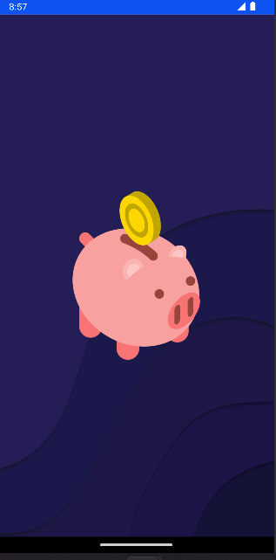
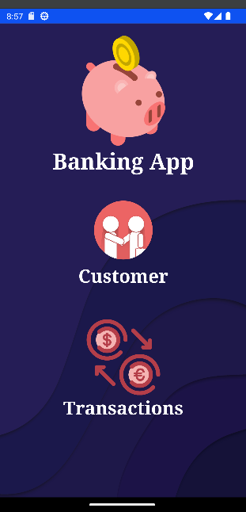
APP INTERFACE

Slide 6

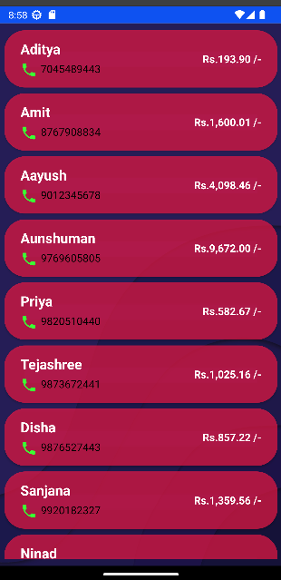
TRANSACTIONS
Customers

Slide 7
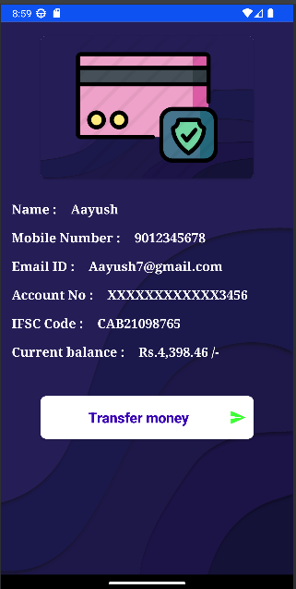
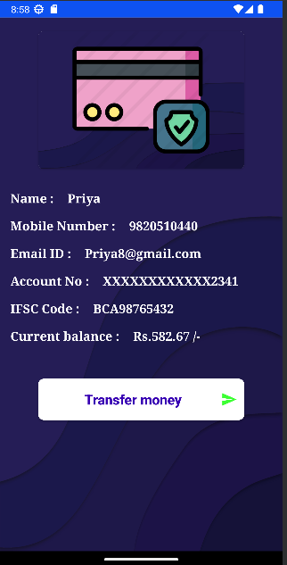
Account details

Slide 8
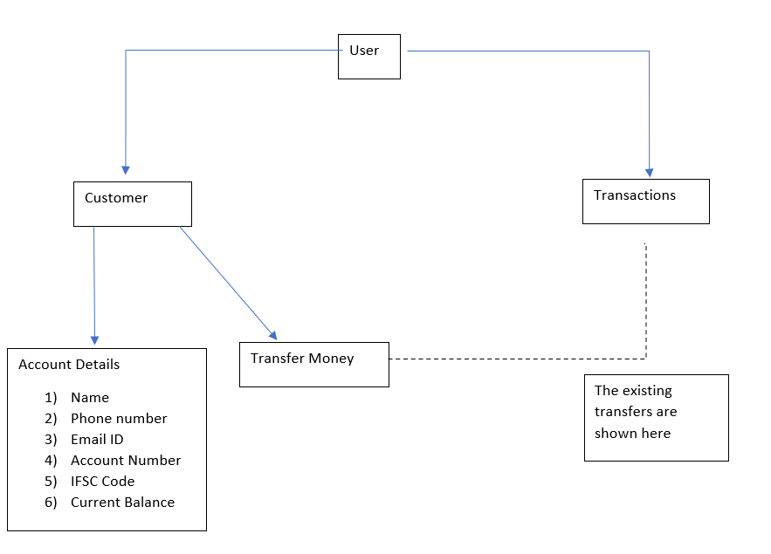
WORKFLOW

Slide 9
Thank you
SAVALI CHAVAN
KHUSHI DAGA
SHUBHANKAR DAM

